Slide 1
WFI32 Anycloud AT+CMD
Luc Archambault
Jan 2023

Slide 2
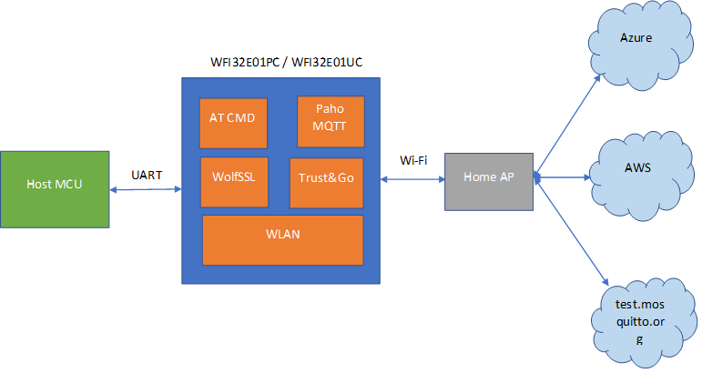
WFI32 AnyCloud
Public release on GitHub
https://github.com/MicrochipTech/PIC32MZW1_AnyCloud

Slide 3
Features
Easy to learn ASCII AT commands for adding Wi-Fi and Cloud connectivity to any processor
Mutual authentication supported with AWS and Azure
Server authentication supported for test.mosquitto.org
Designed for WFI3E01PC and WFI32E01UC modules with integrated Trust&Go (TNG)
Single pre-built hex file supports all features for majority of use cases. No need to recompile image for different cloud vendors (single image supports connectivity with AWS / Azure / test.mosquitto.org)
Complete source to enable customization when required
Supports MQTT, Socket programming(TCP/ UDP), SNTP, TLS (v1.3/ v1.2), ICMP, IGMP, DNS, DHCP, Low Power, WPA3, Loading/ Reading Certificates via UART, WiFi Provisioning.
Features like OTA, Trust Flex, IPv6, mDNS planned for future releases.

Slide 4
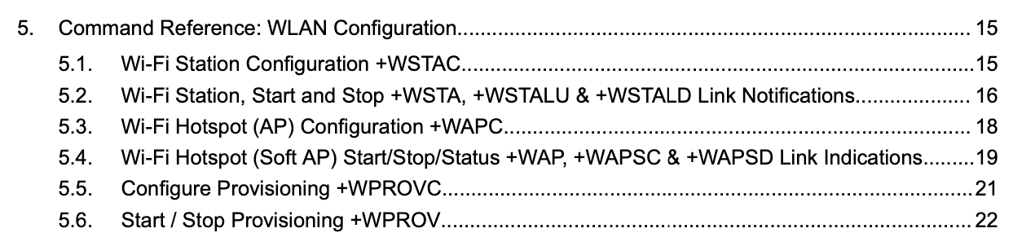
WLAN

Slide 5
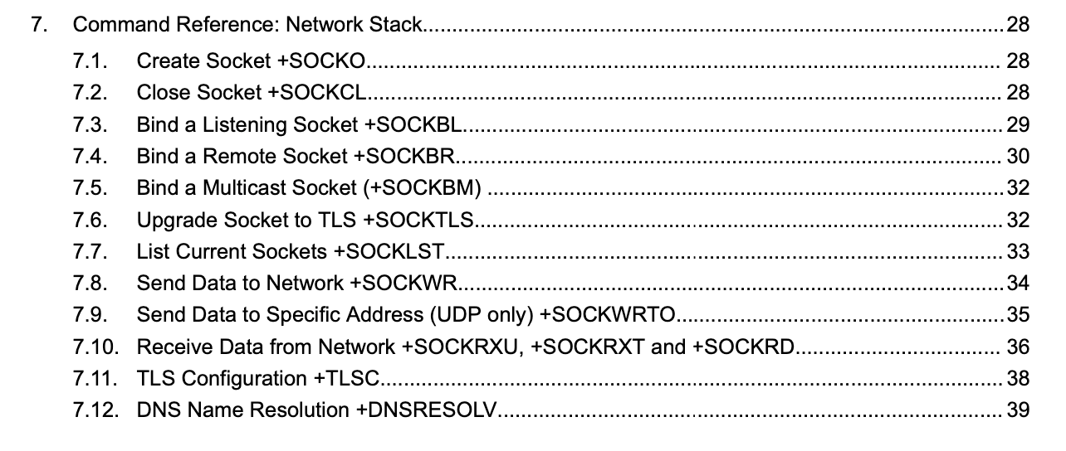
Network

Slide 6
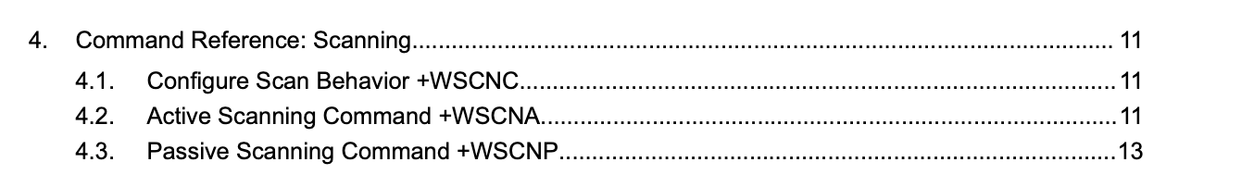
WSCAN

Slide 7
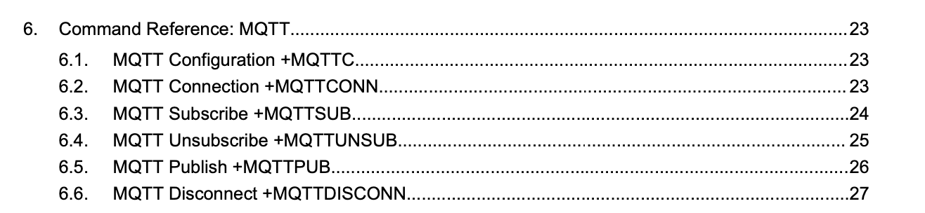
MQTT

Slide 8
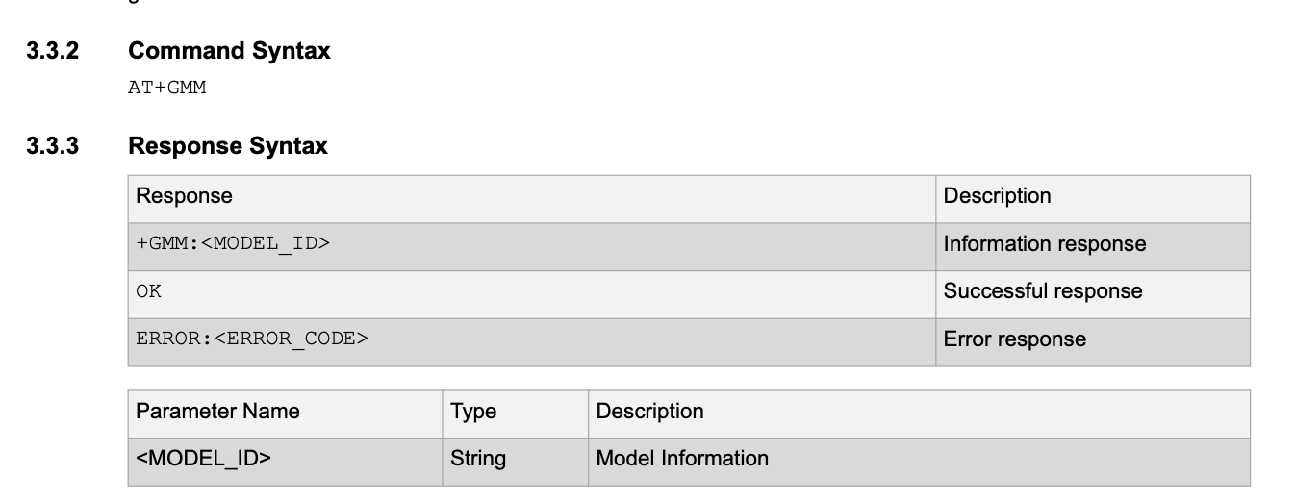
WFI32 AnyCloud.
AT+CMD
Immediate response
+CMD:<value1>,<value2>,…
OK or ERROR

Slide 9
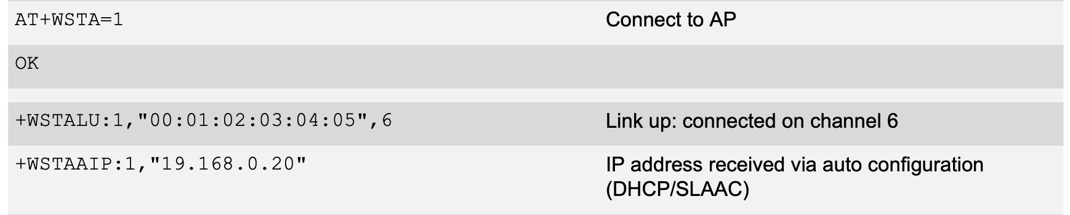
WFI32 AnyCloud
AT+CMD
Immediate Response
OK or ERROR
Asynchronous response:
+ABC:<value1>,<value2>,…
+DEF:<value1>,<value2>,…
Notes:
AT+RST
ATE0
AT+WSTAC=1,"LucHelix2_4G"
AT+WSTAC=2,3
AT+WSTAC=3,"luc461helix"
AT+WSTAC=12,"pool.ntp.org"
AT+WSTAC=13,1
AT+WSTAC=14,1
AT+WSTA=1
AT+SOCKO=1
AT+SOCKBL=SKT,30303
AT+SOCKWRTO=13550,"255.255.255.255",30303,11,"Hello World"

Slide 10
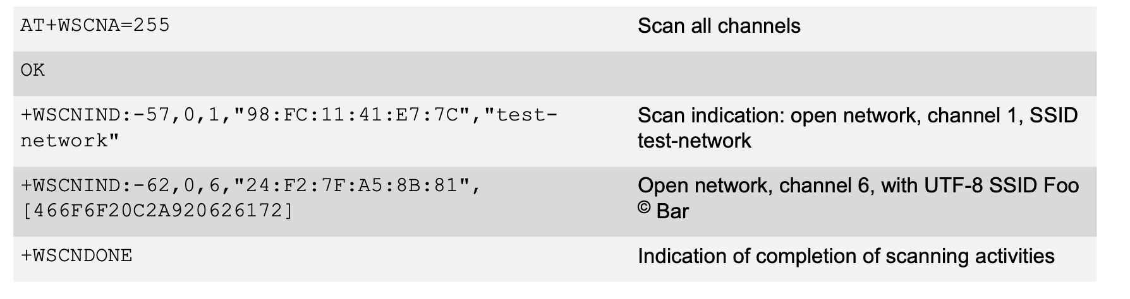
WFI32 AnyCloud (Live demo)
AT+CMD
Immediate Response
OK or ERROR
Asynchrounous response:
+ABC:<value1>,<value2>,…
+DEF

Slide 11
WFI32 AnyCloud
STATION Setup
AT+WSTAC=1,"DEMO_AP”
OK
AT+WSTAC=2,3
OK
AT+WSTAC=3,"password"
OK
AT+WSTAC=4,255
OK
AT+WSTAC=12,"pool.ntp.org"
OK
AT+WSTAC=13,1 AT+WSTA=1
OK
Async events
+WSTALU:"42:2C:62:CC:C0:0B",11
+WSTAAIP:"192.168.159.108"
+TIME:2,3864185092

Slide 12
WFI32 AnyCloud
MQTT Setup
AT+MQTTC=1,"youramazonaws.com"
OK
AT+MQTTC=2,8883
OK
AT+MQTTC=3,"yourDeviceId"
OK
AT+MQTTCONN=1
OK
Async events
+MQTTCONNACK:0,0
+MQTTCONN:1

Slide 13
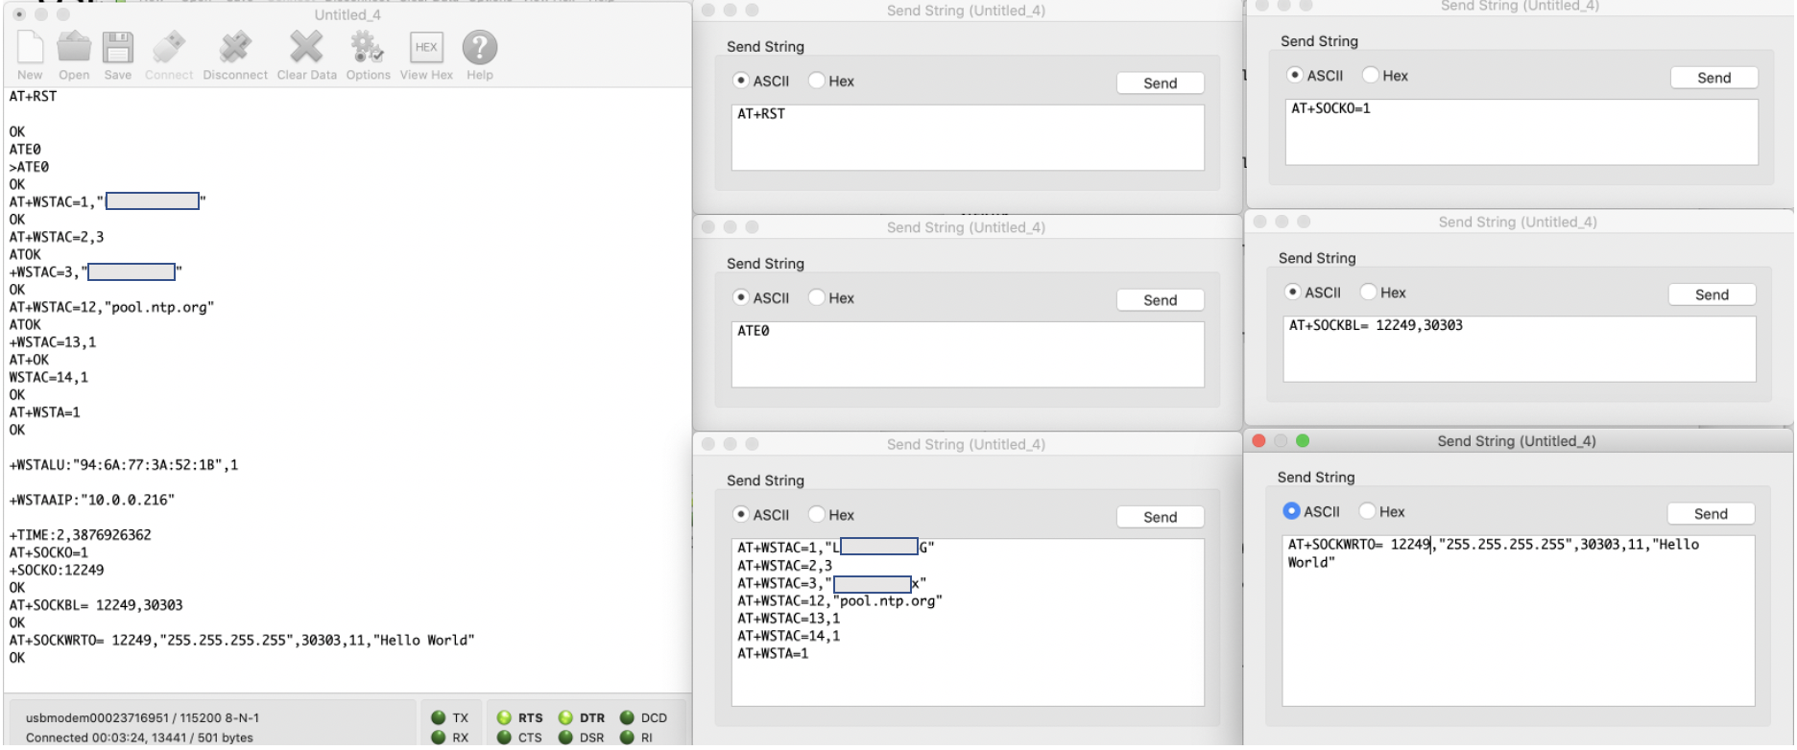
CoolTerm Stationmode
RST
Echo OFF (ATE0)
Config and Connect to AP
Create a UDP Socket
Bind UDP Socket Local to port 30303
Broadcast ”Hello World\r\n"
Notes:
AT+RST
ATE0
AT+WSTAC=1,"LucHelix2_4G"
AT+WSTAC=2,3
AT+WSTAC=3,"luc461helix"
AT+WSTAC=12,"pool.ntp.org"
AT+WSTAC=13,1
AT+WSTAC=14,1
AT+WSTA=1
AT+SOCKO=1
AT+SOCKBL=SKT,30303
AT+SOCKWRTO=13550,"255.255.255.255",30303,11,"Hello World"

Slide 14
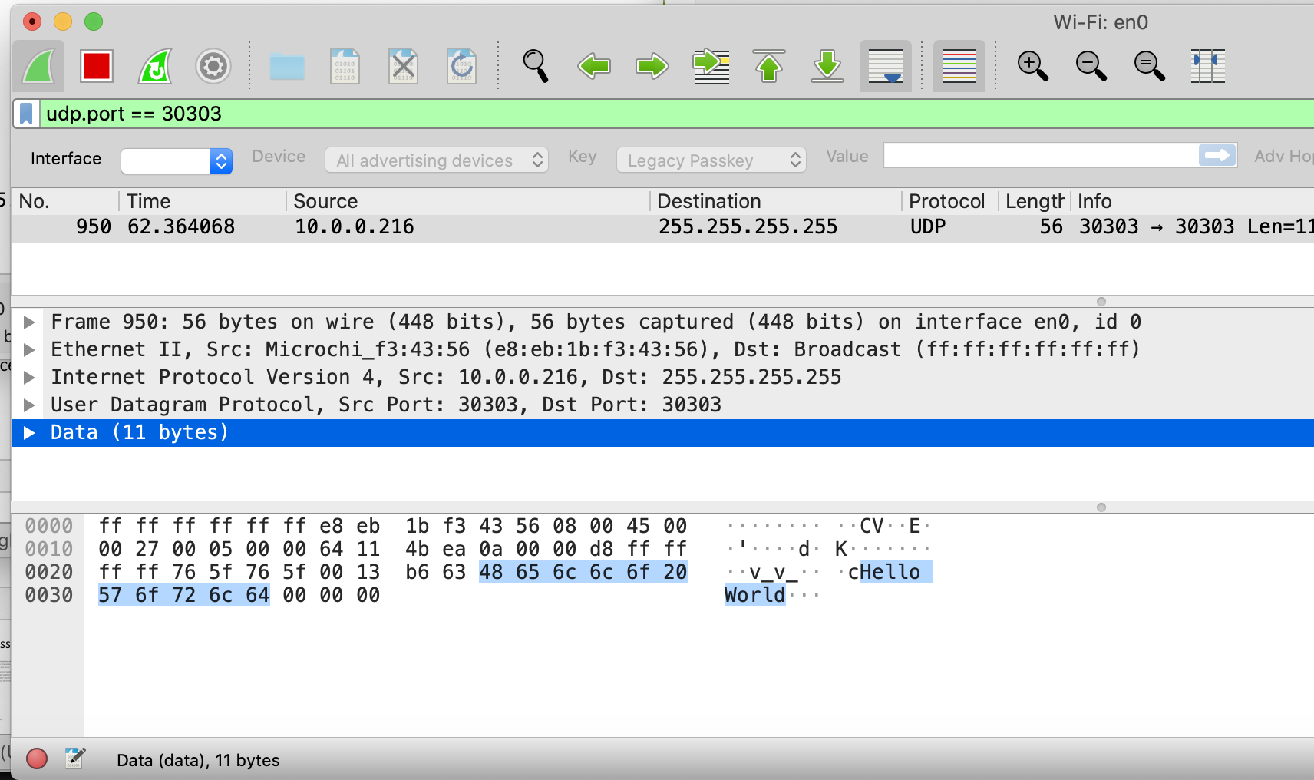

Slide 15
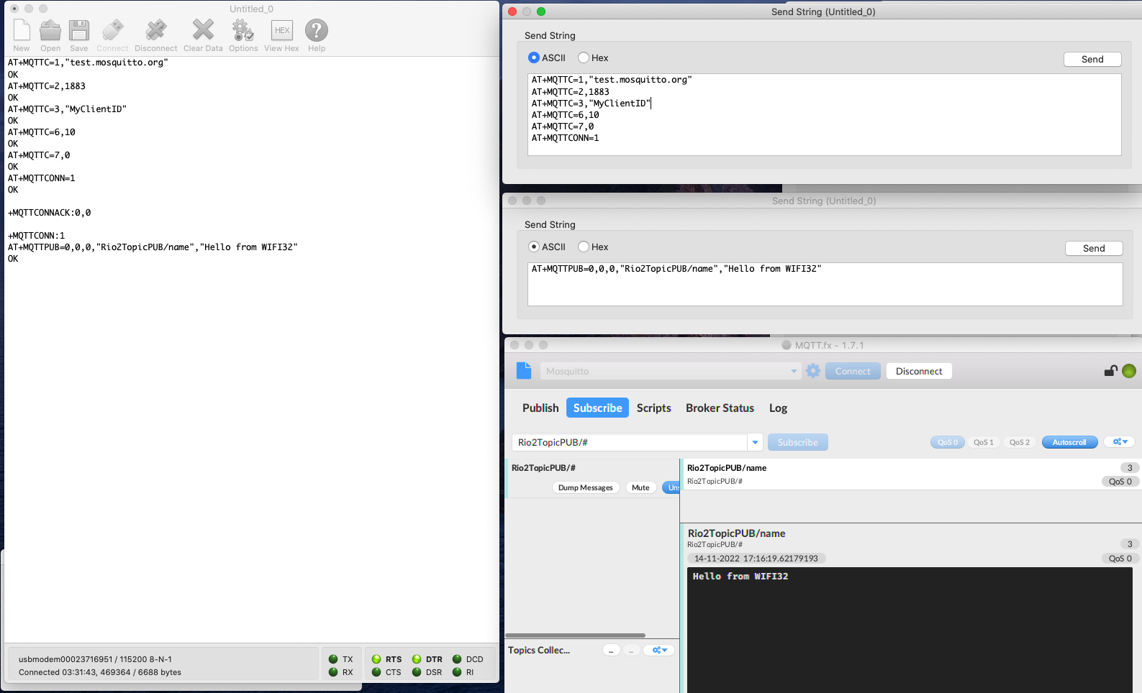
CoolTerm MQTT MOSQUITTO
Notes:
AT+MQTTC=1,"test.mosquitto.org"
AT+MQTTC=2,1883
AT+MQTTC=3,"MyClientID"
AT+MQTTC=6,10
AT+MQTTC=7,0
AT+MQTTCONN=1
AT+MQTTPUB=0,0,0,"Rio2TopicPUB/name","Hello from WIFI32"

Slide 16
AT+CMD with HOST Processor

Slide 17
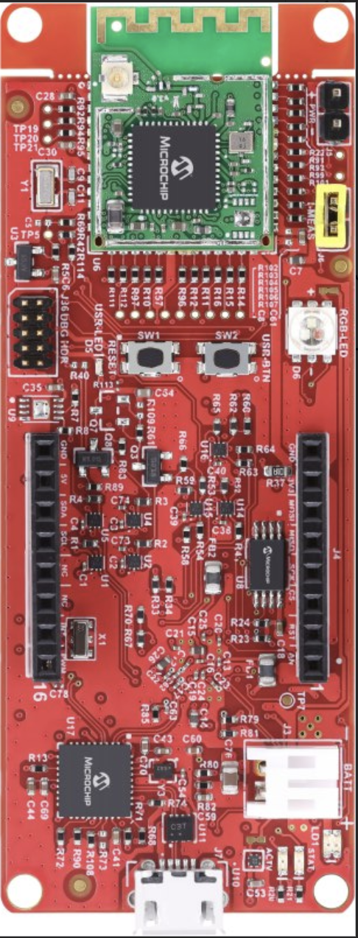
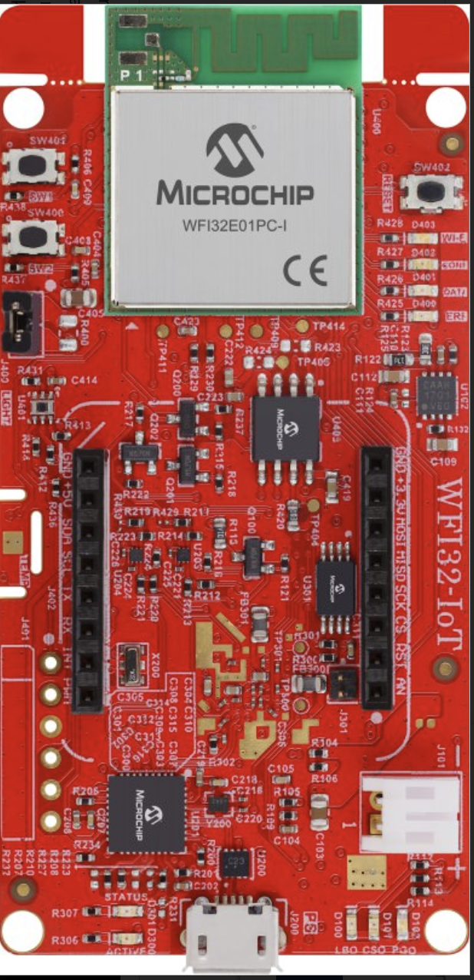


WBZ451
WFI32 IoT

Slide 18
Host WBZ451
WBZ451
SERCOM0 @ 115200 VCP (connected to MCP2200)
SERCOM1 @ 230400 for AT+CMD to WFI32 IoT
TC3 for Clock Tick event
2 Apps
app.c
app_rio2.c
WFI32 IoT
Preprogrammed for AnyCloud

Slide 19
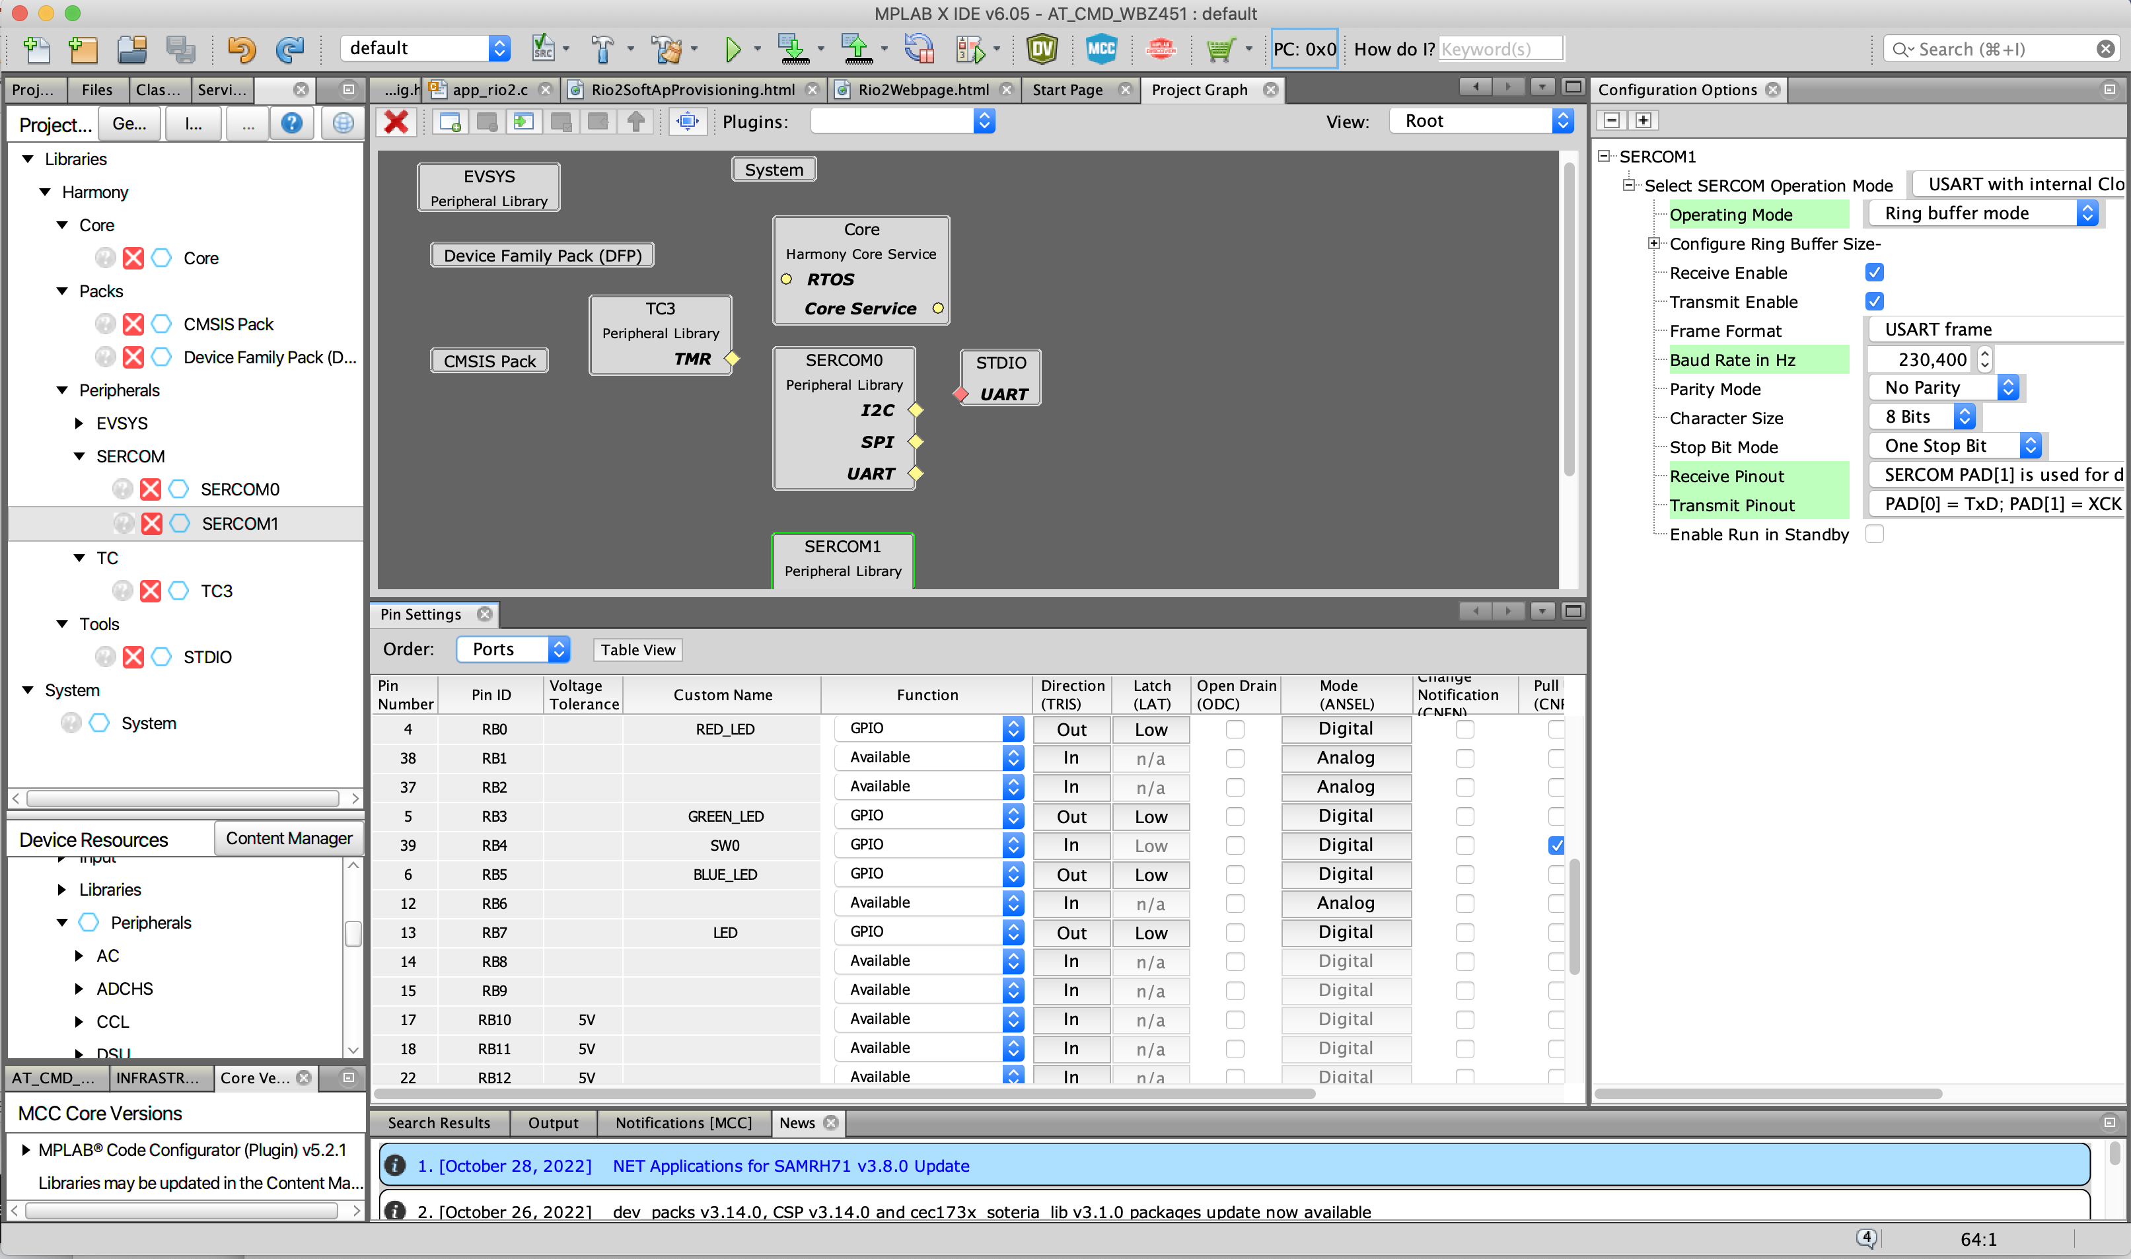

Slide 20
General State Machine

Slide 21
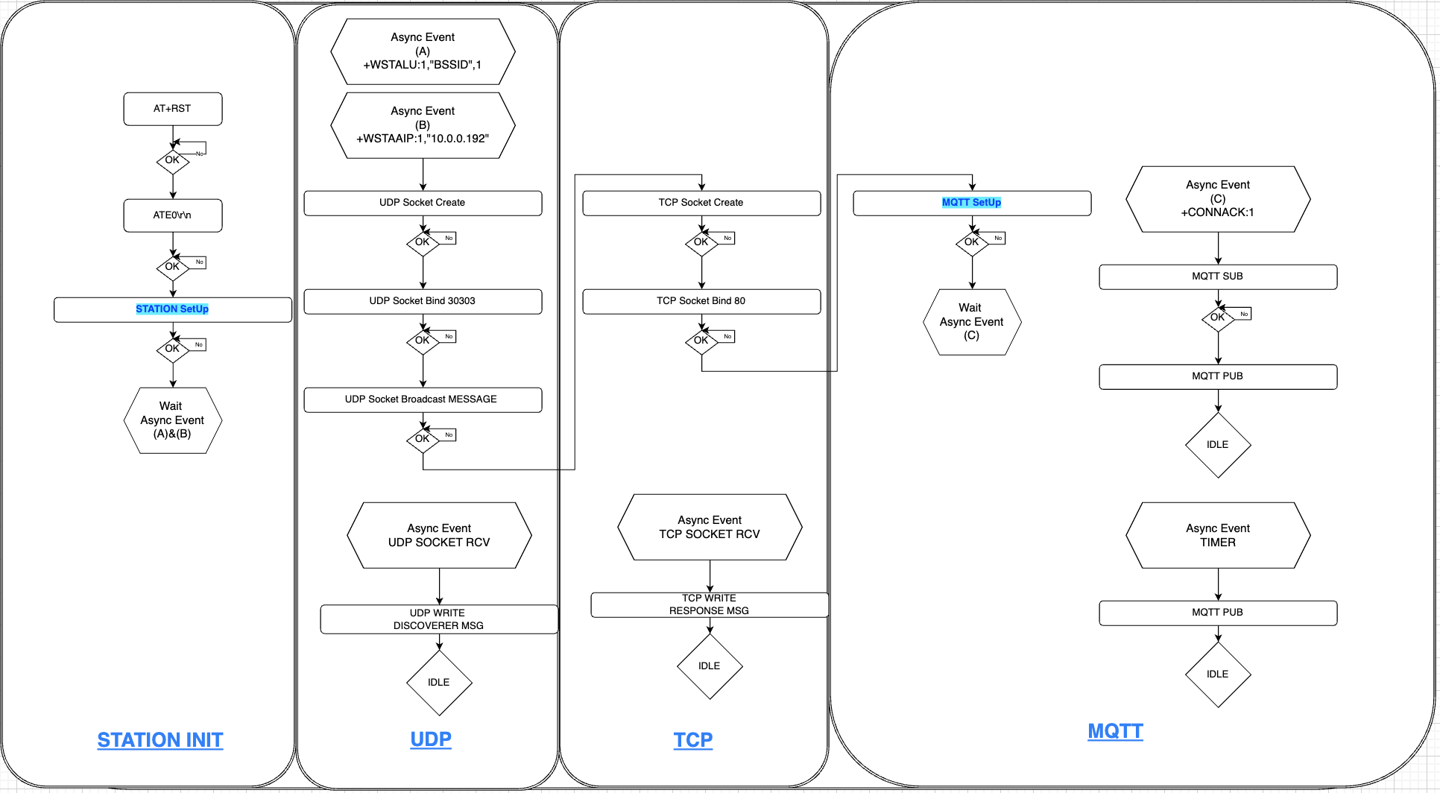

Slide 22
AT+CMD State Machine
Some State machine requires many AT+CMD
For Configuring for STATION or MQTT
Just require the OK response from WFI32
Some other State Machine requires one AT+CMD
For creating a TCP Socket
In addition to OK, socket number is required for Binding SKT with PORT (Local or Remote)

Slide 23
Multiple AT+CMD per State Machine

Slide 24
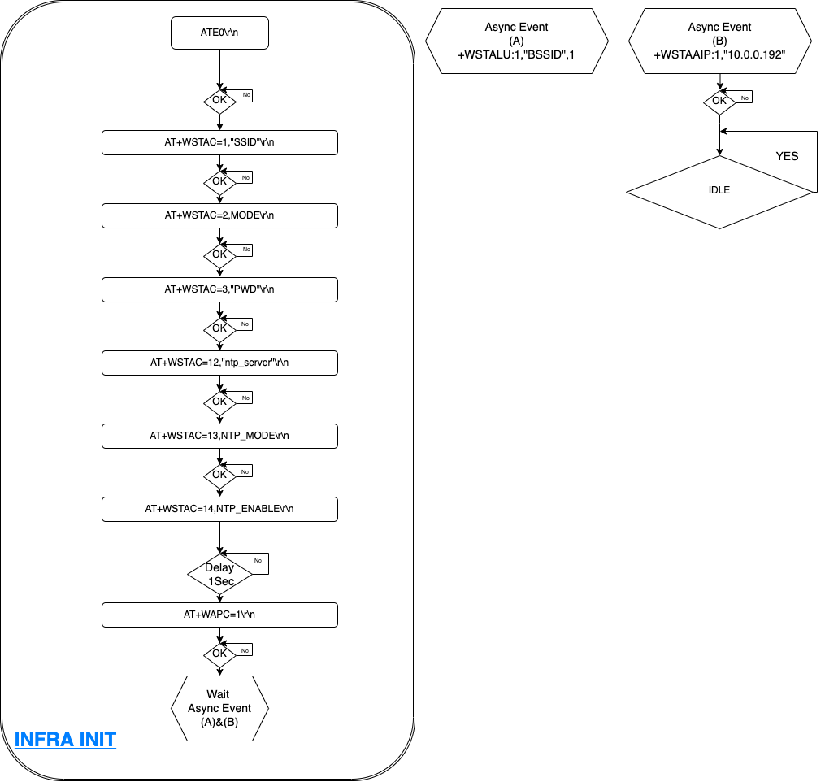
SetUp for INFRASTRUCTURE/STATION
Create ONE state machine for each AT+CMD
OR

Slide 25
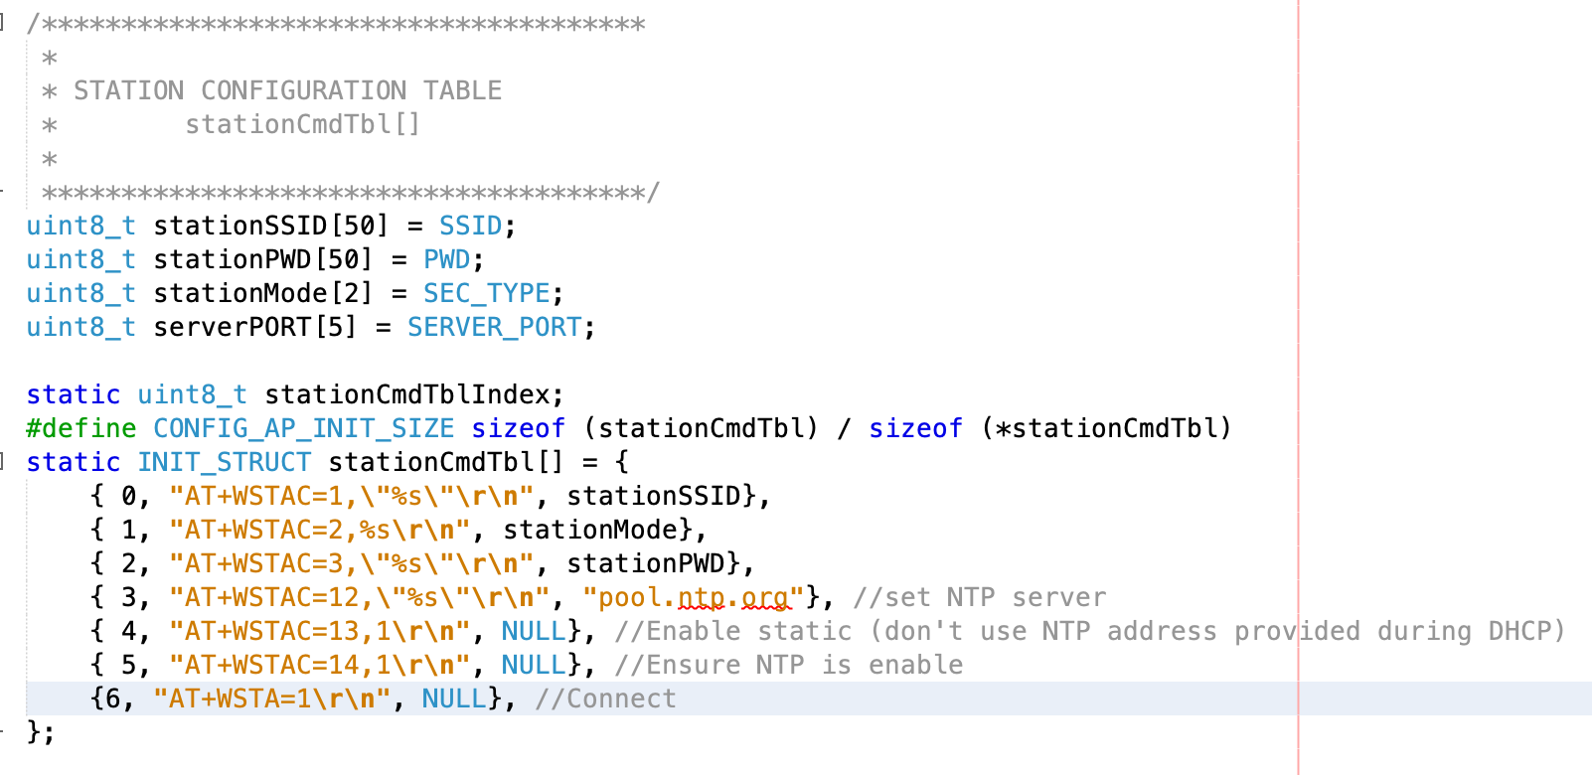
AT Command Station Setup Structure

Slide 26
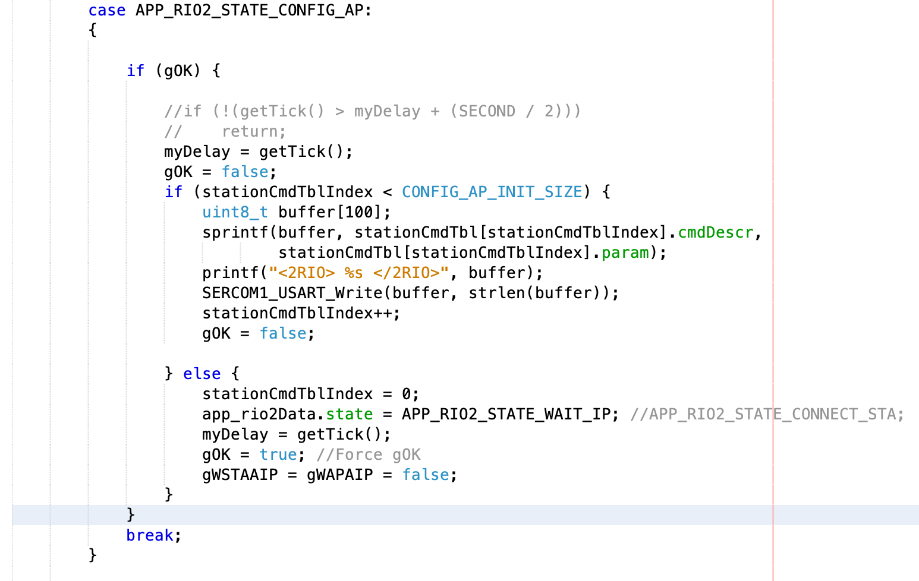
Code Configuring Station mode
gOK = 1
Done Configuring Station Mode
Wait for IP

Slide 27
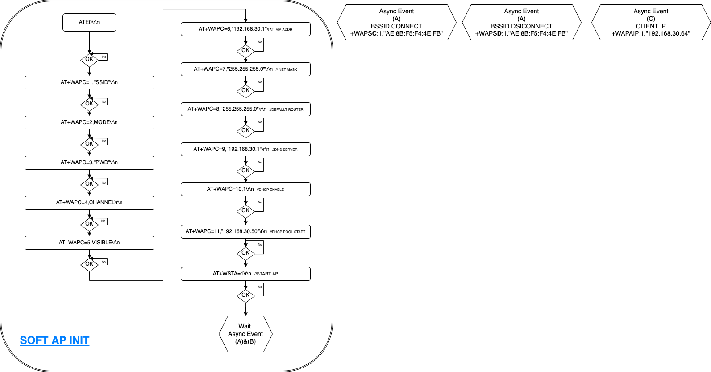

Slide 28
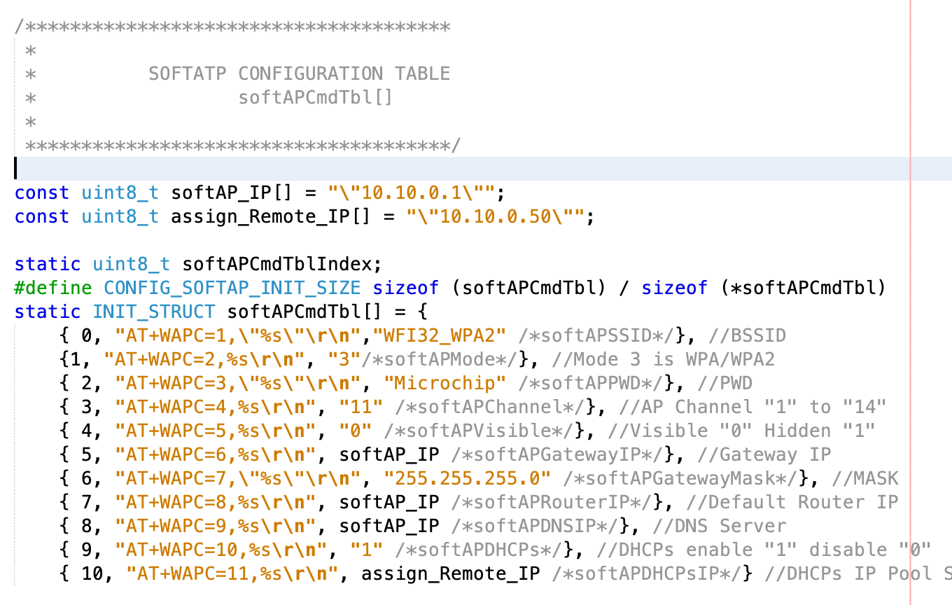
AT Command SofAP Setup Structure

Slide 29
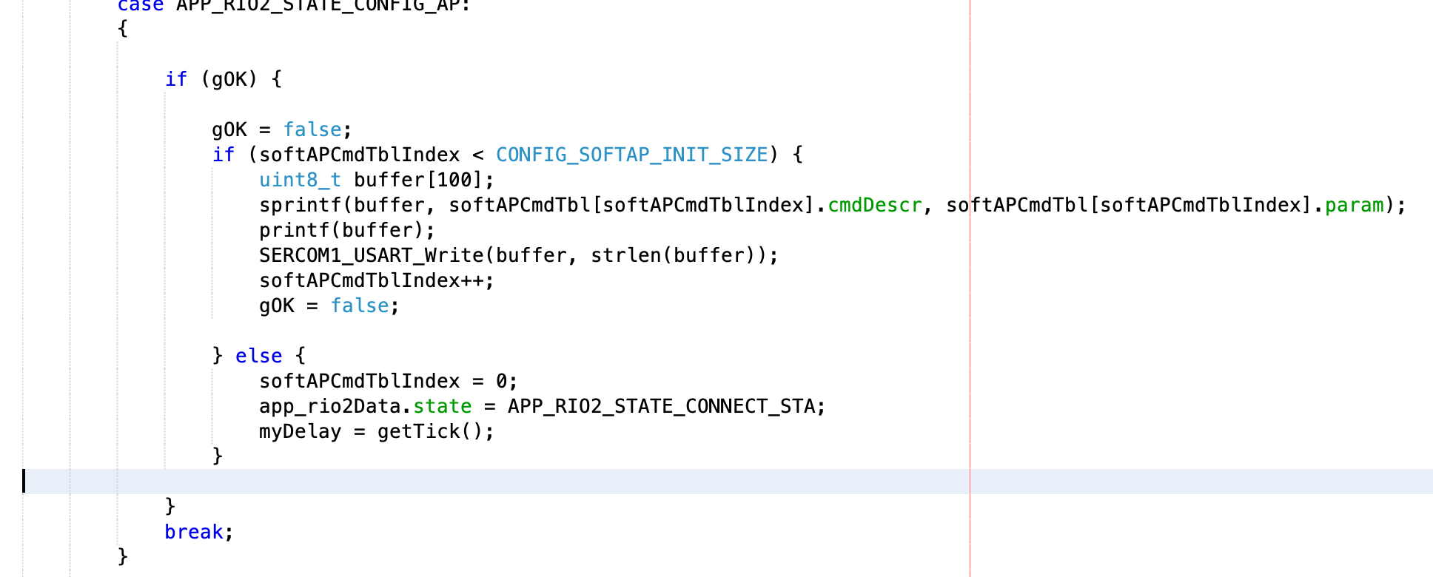
Code Configuring SoftAP mode

Slide 30
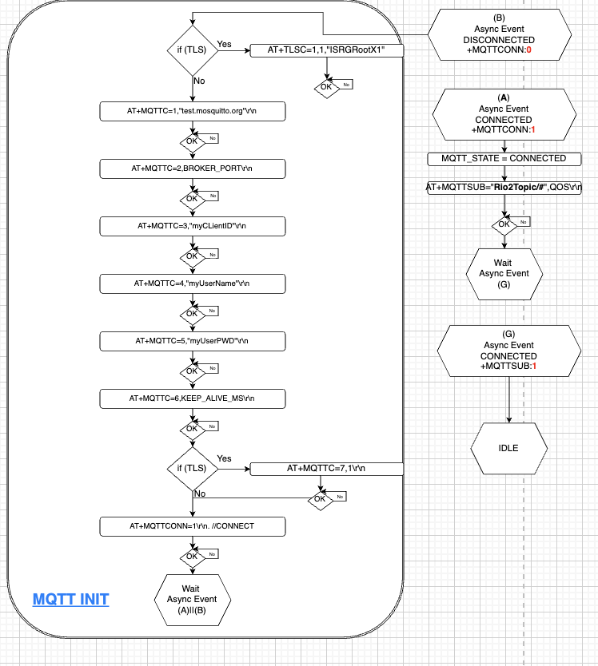

Slide 31
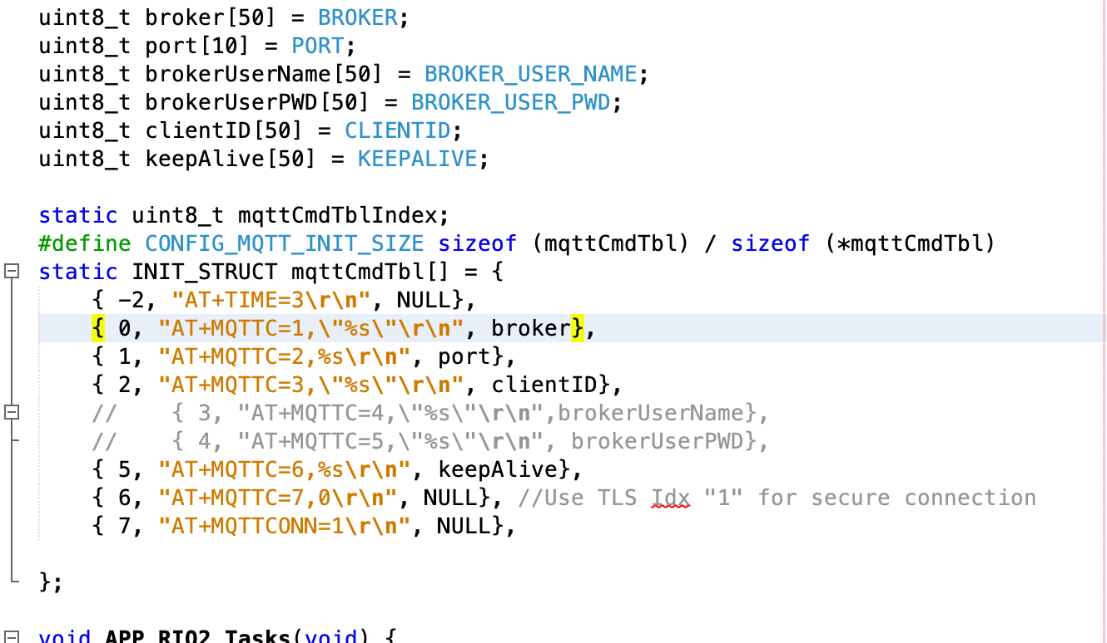
AT Command MQTT Setup Structure

Slide 32
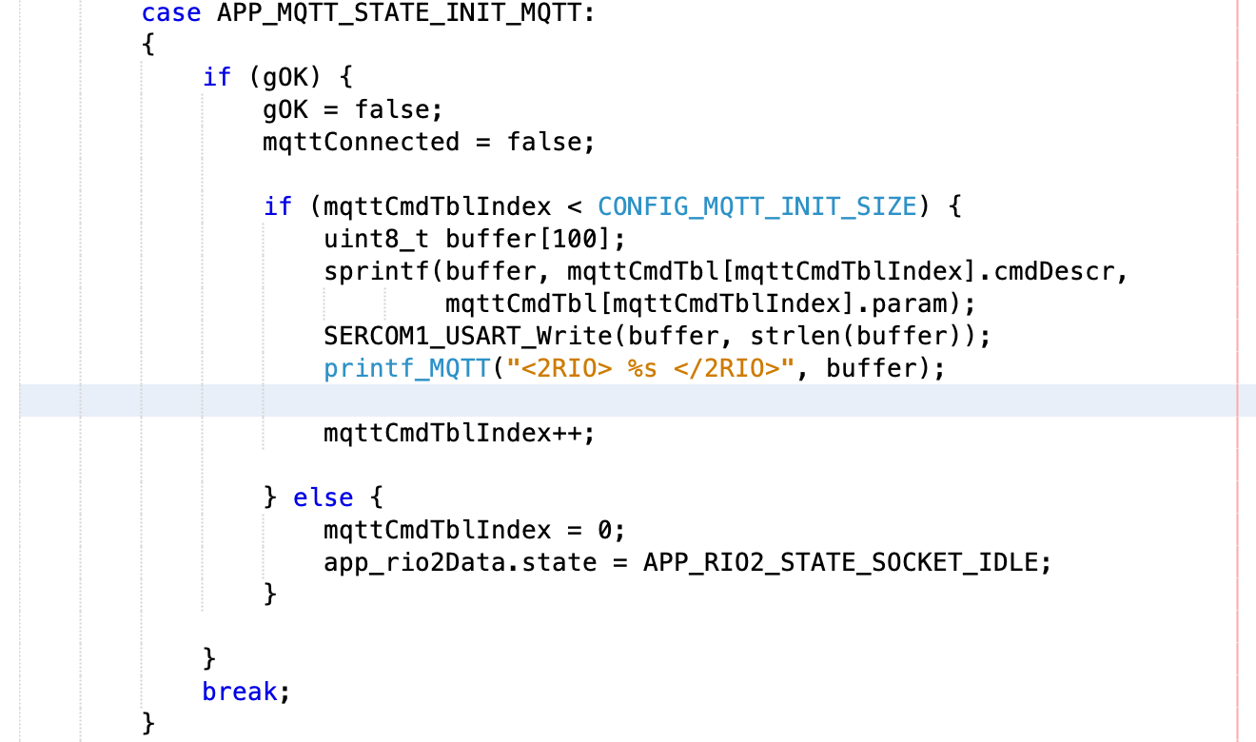
Code Configuring MQTT mode

Slide 33
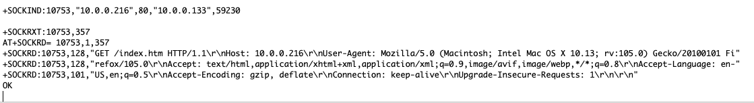
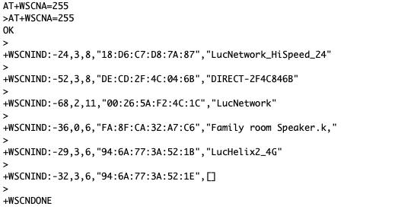
Received Message from WFI32
SERCOM1
Circular buffer Interrupt driven
Large enough for
Receive multiple messages. (1024)
Transmit large packet (512)

Slide 34
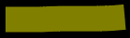

Circular Buffer
First message..
First message..Second message..
First message..Second message..Third messa
ge..
First message..Second message..Third messa
ge..Fourth message..F
ifth message..Sixth m
essage..
First message..Second message..Third messa
ge..Fourth message..F
ifth message..
age..message..Second message..Third messa
ge..Fourth message..F
ifth message..Sixth m
essage..Seventh mess
First message..Second message..Third messa
ge..Fourth message..
How do I parse through a Circular Buffer?

Slide 35
Parsing Message
From SERCOM1 Circular Buffer
Read 1 byte at a time until CR-LF is found
Copy line to Linear Buffer with NULL terminated
Use (STRSTR) to compare line with ATCMD Response Structure
Execute CallBack based on valid search!

Slide 36

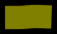
Circular Buffer
Linear Buffer
First message..
First message..Second message..
First message..Second message..Third messa
ge..
First message..Second message..Third messa
ge..Fourth message..F
ifth message..Sixth m
essage..
First message..Second message..Third messa
ge..Fourth message..F
ifth message..
age..message..Second message..Third messa
ge..Fourth message..F
ifth message..Sixth m
essage..Seventh mess
First message..Second message..Third messa
ge..Fourth message..
First message..
First message..Second message..
First message..Second message..Third messa
ge..
First message..Second message..Third messa
ge..Fourth message..F
ifth message..Sixth m
essage..
Seventh message..ond message..Third messa
ge..Fourth message..F
ifth message..Sixth m
essage..
First message..Second message..Third messa
ge..Fourth message..F
ifth message..
First message..Second message..Third messa
ge..Fourth message..
Notes:
Linear buffer could be as small as holding ONE line from WFI32.
But making it larger allows you to hold many response from WFI32 and process that information later in the state machine

Slide 37
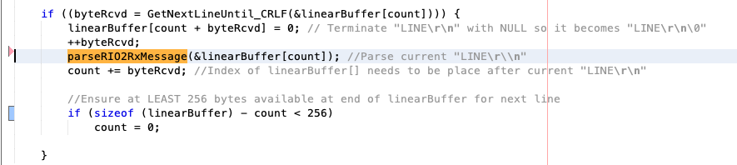
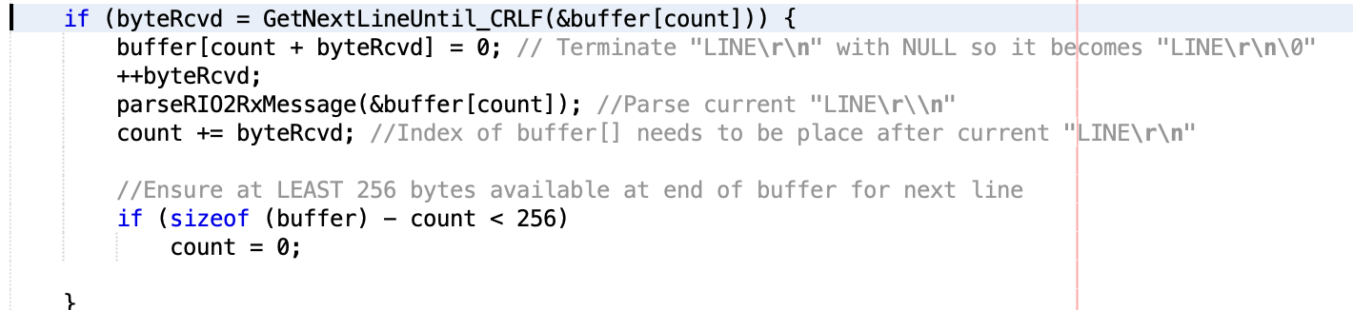

Slide 38
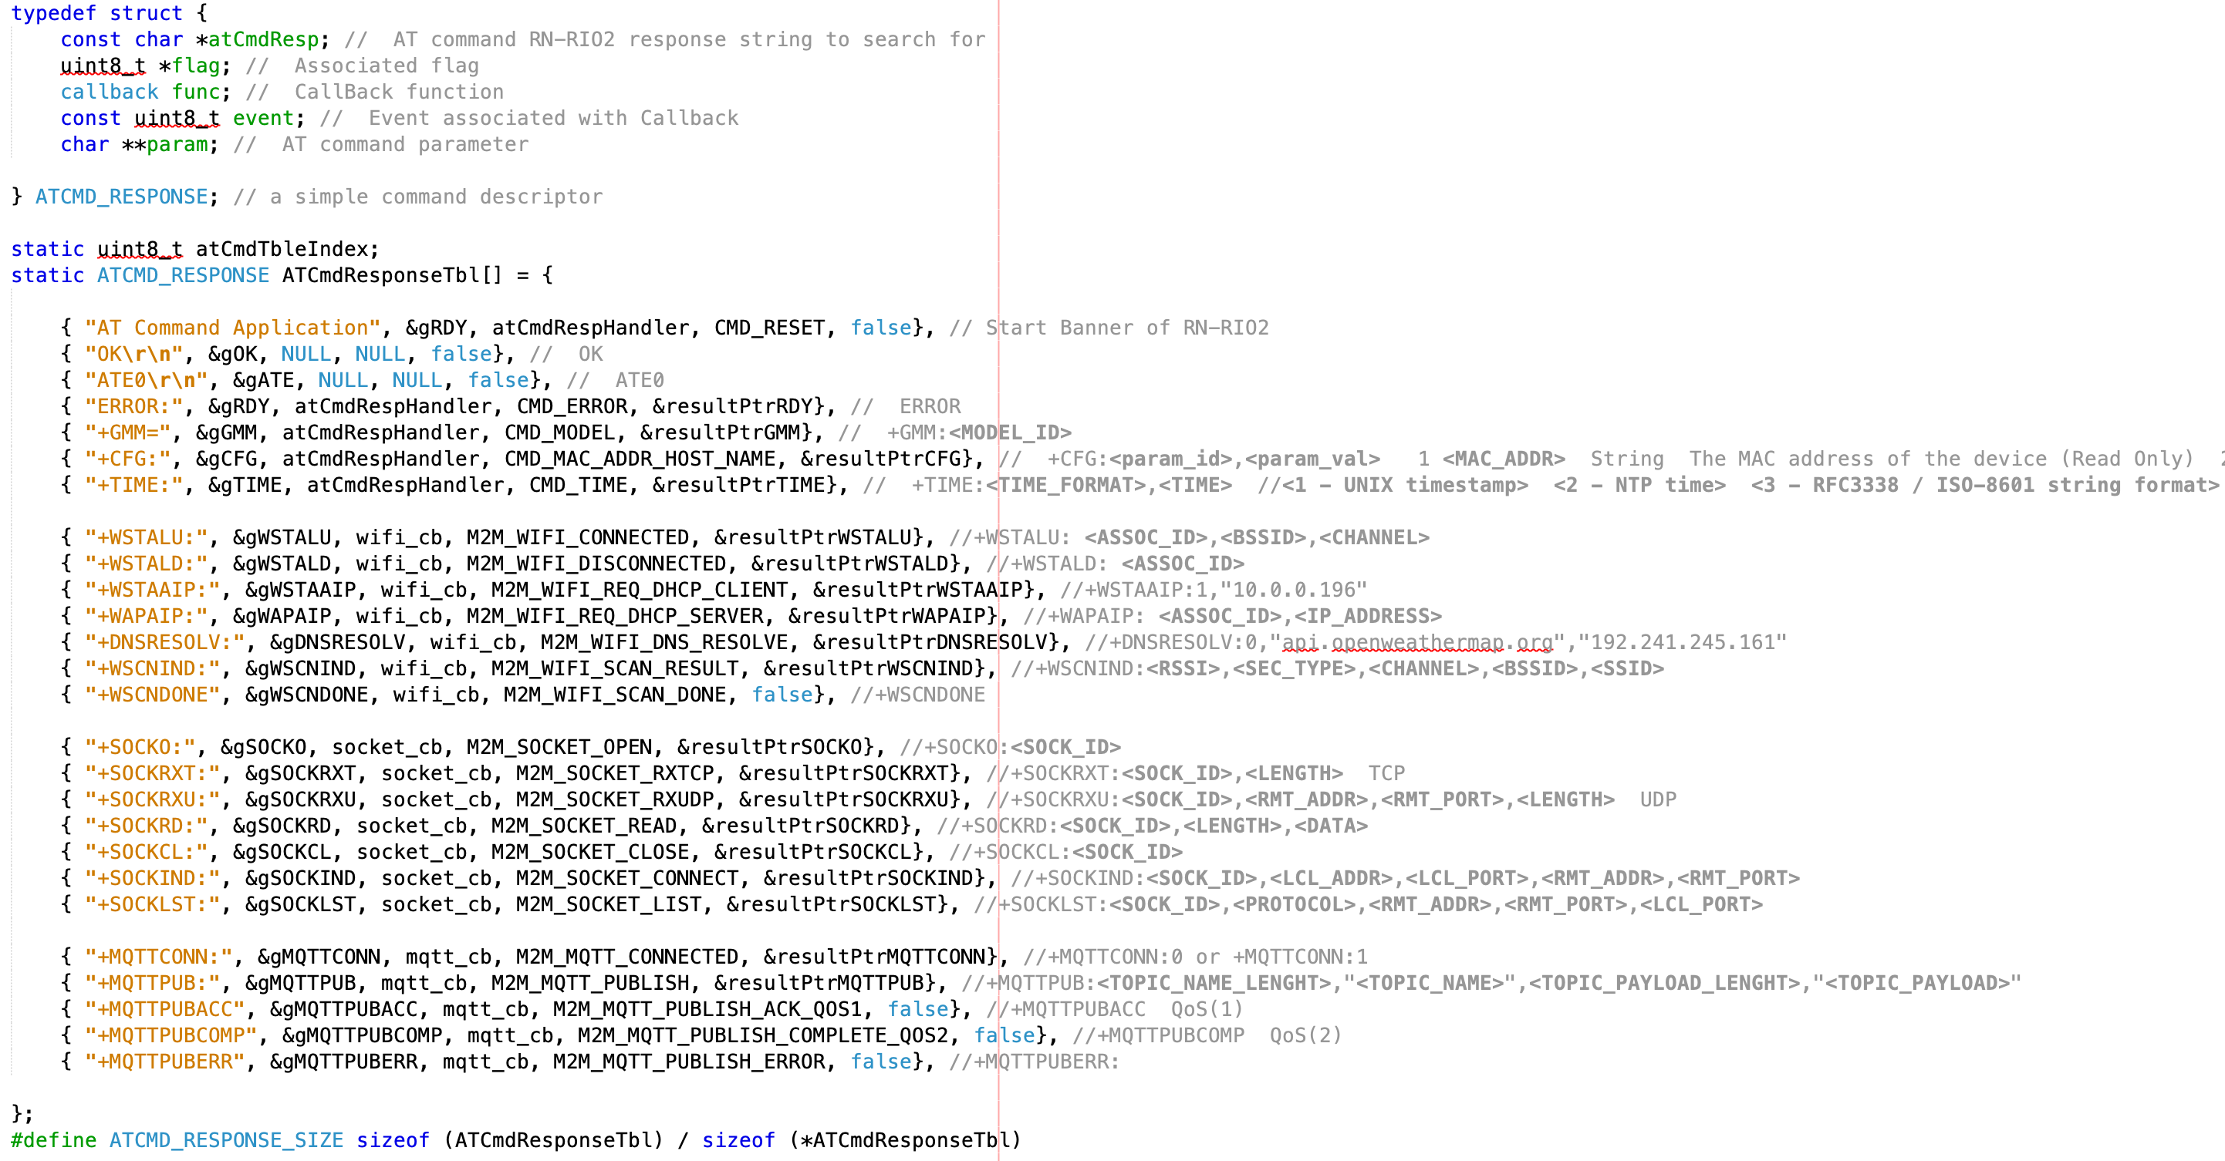
AT Command Response Parsing Structure
callBack
function
callBack
event
callBack
Parameter
pointer
String to compare
Flag to set for event

Slide 39
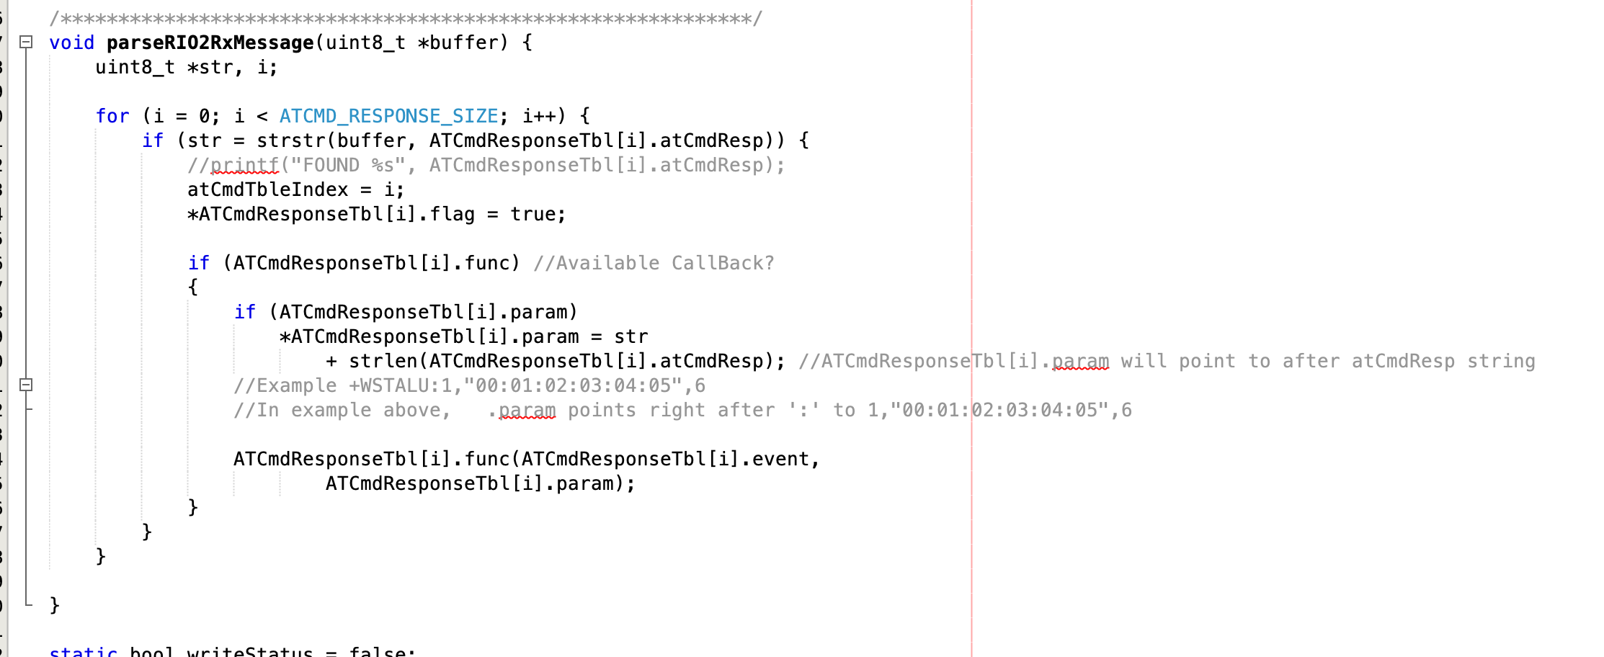
Code parsing over all possible response
Notes:
Parse all line from Table

Slide 40
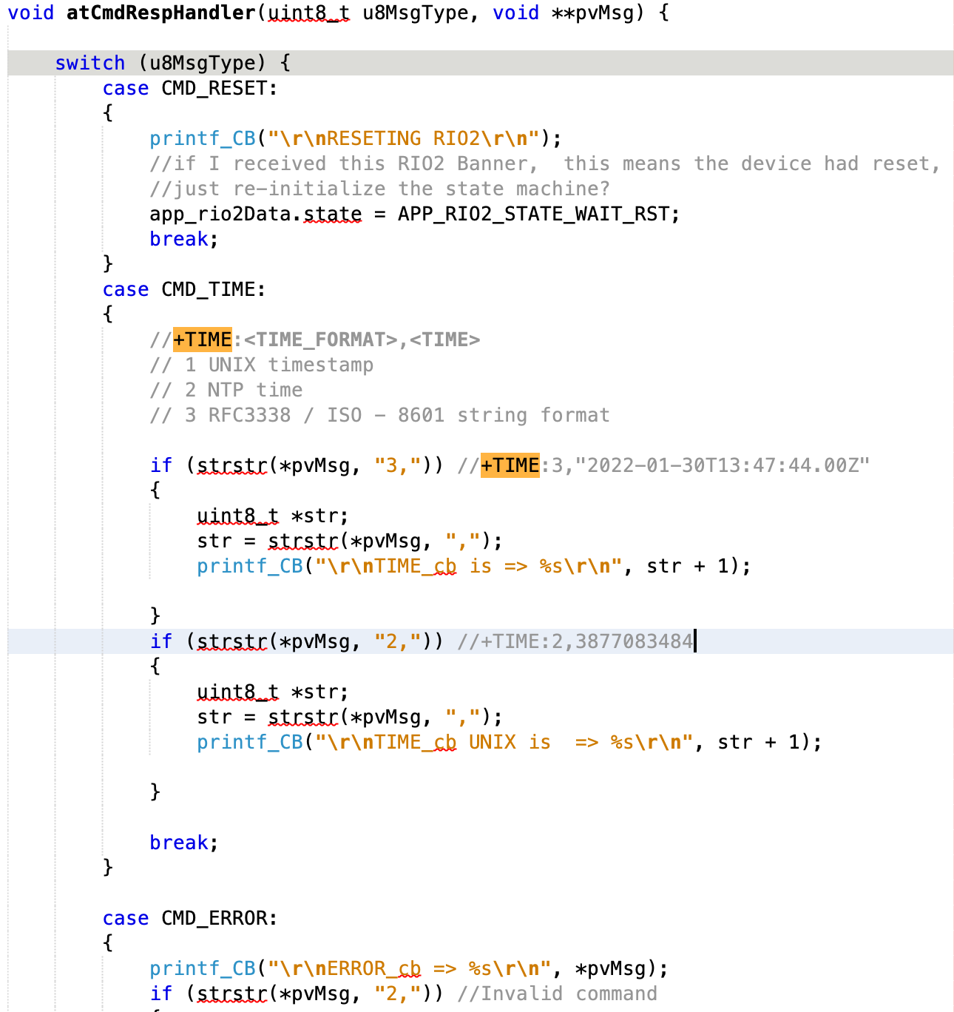
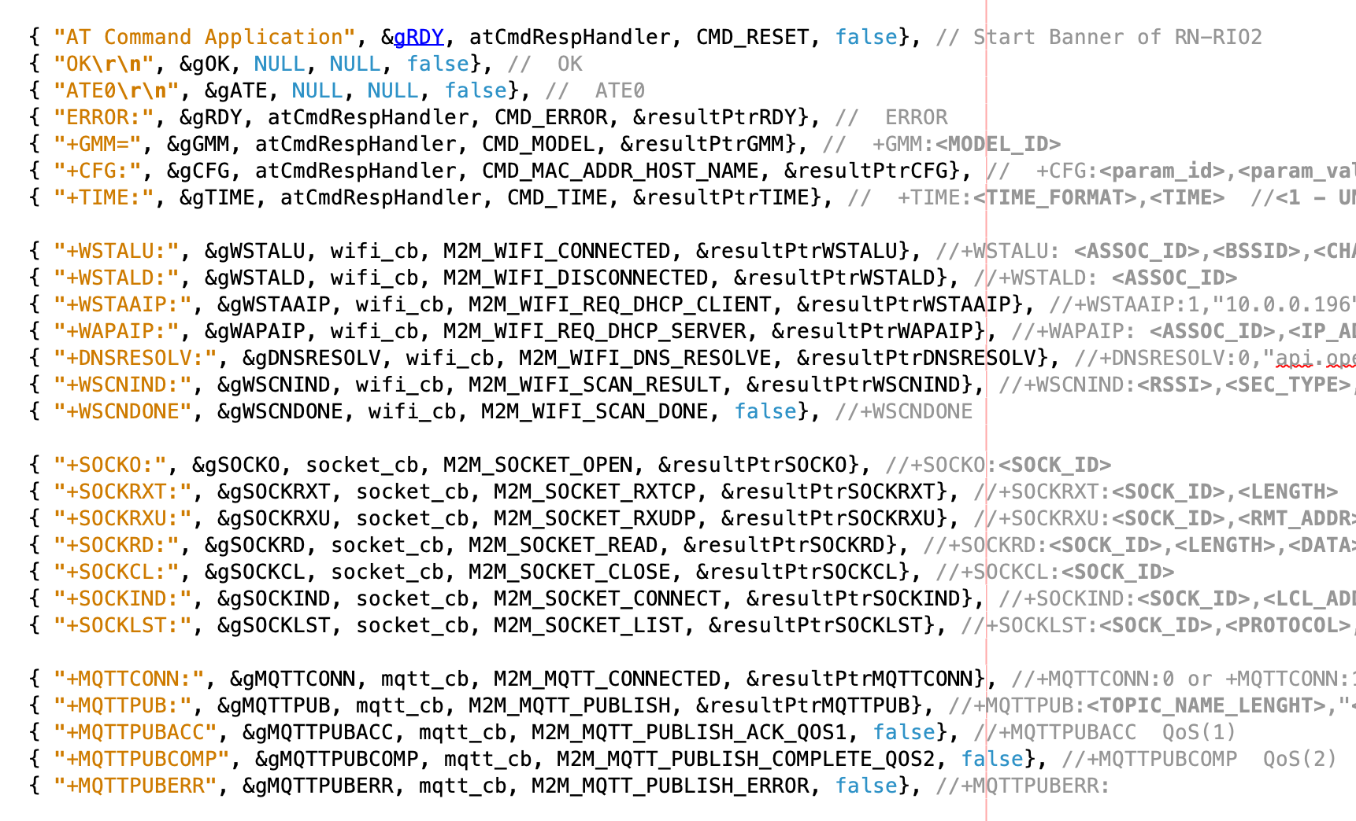
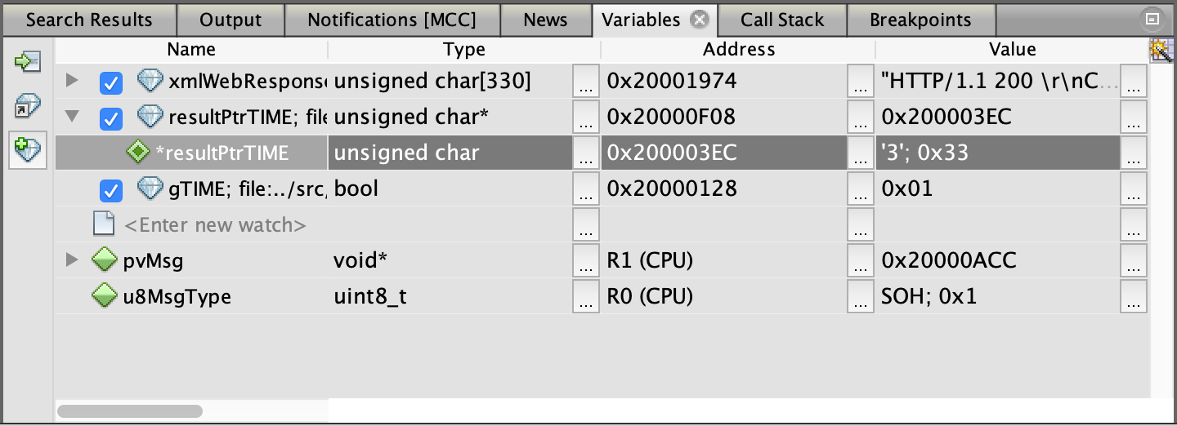
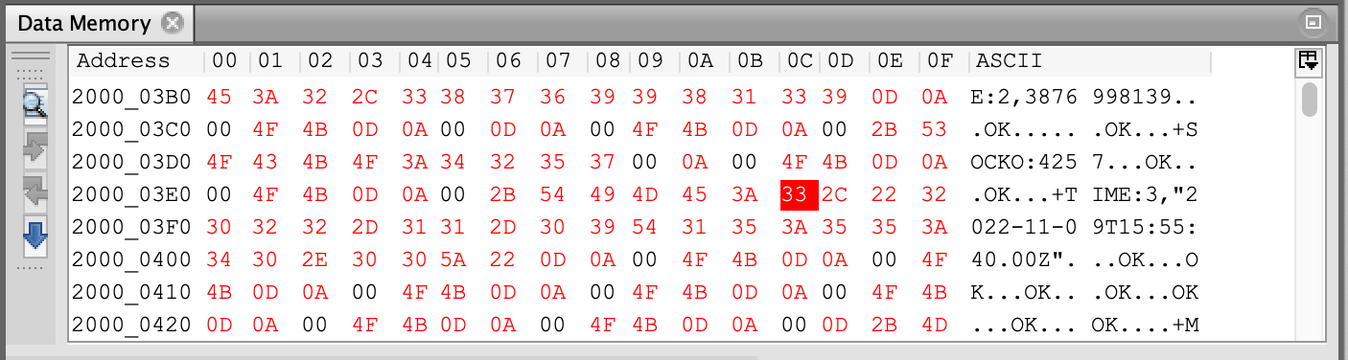
CallBack function example
AT+TIME=3
+TIME:3,"2022-11-09T15:37:16.00Z"

Slide 41
Live demo !

Slide 42
Addendum

Slide 43
Certificate loading to CLoud

Slide 44
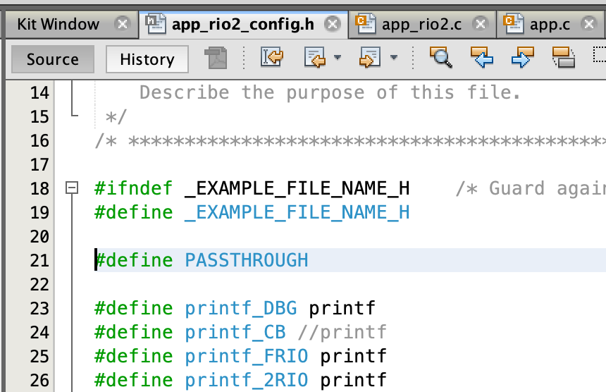
AWS
In app_rio2_config.h. enable PASSTHROUGH

Slide 45
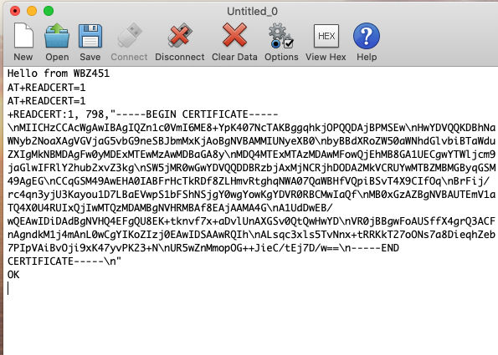
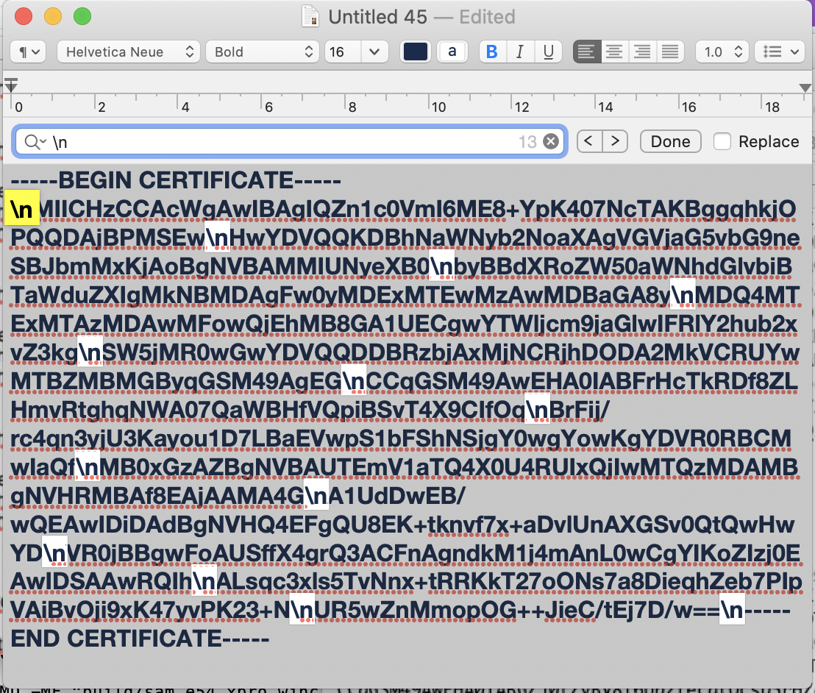
AWS
In Terminal window (115,200), type AT+READCERT=1 to read Device Certificate
Copy everything from -----BEGIN CERTIFICATE----- to -----END CERTIFICATE-----
Paste this into a text editor. You will need to replace all instance of "\n" with CR (Carriage Return). Save as “WFI32_DeviceCert.cer”

Slide 46
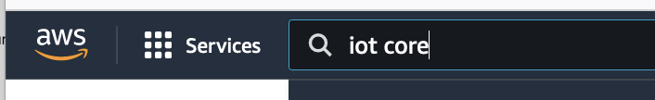
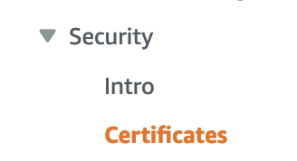
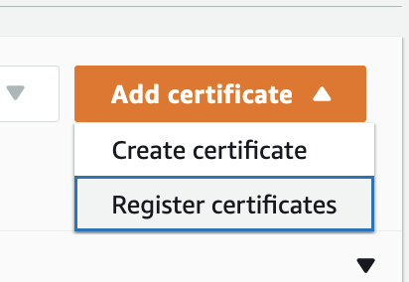
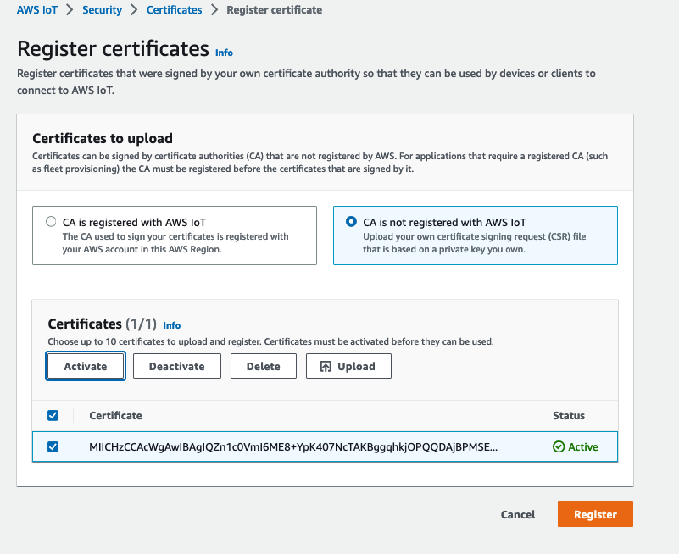
AWS load Certificate
From your AWS Account goto IoT Core¹.
From IoT Core window, on the left margin, select Security->Certificates²
In the ”Add certificate” ³ pull down, select “Register certificates” ⁴
From the Register certificates page, select “CA is not registered with AWS IoT” ⁵. Click “Upload” ⁶ and load the the DevCert.cer from WFI32. Check ⁷ the new loaded certificate, click “Activate” ⁸ and verify it is “Active” ⁹. Finally click “Register” ¹⁰.
Next create a “Policy”
1
2
3
4
5
8
6
9
7
10

Slide 47
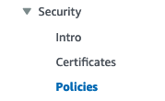
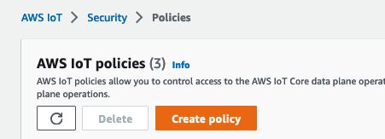
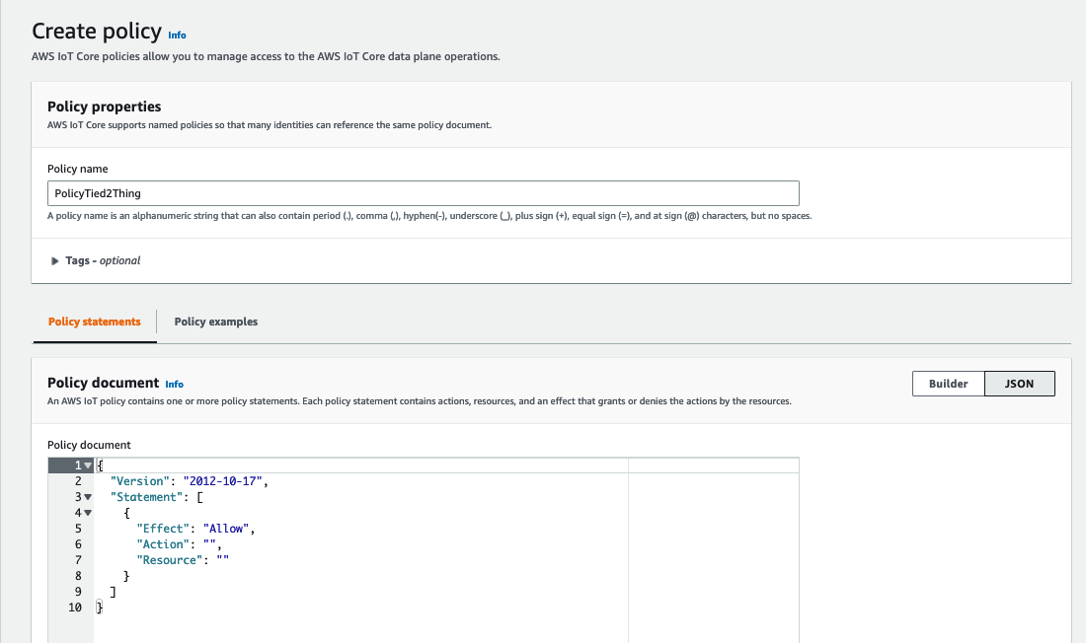
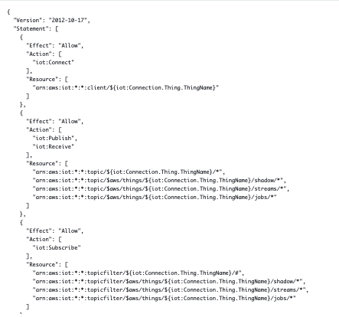
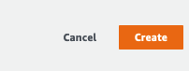
AWS Create Policy
From your AWS Account go to IoT Core¹.
From IoT Core window, on the left margin, select Security->Policies²
Click “Create policy” ³
In “Create policy” window ⁴, enter the policy name “PolicyTied2Thing”⁵, select “JSON” ⁶, and replace content ⁷ with json document ⁸ included in speaker note.
Click “Create” ⁹
Next create a “Thing”
1
2
3
4
5
6
8
7
9
Notes:
{ "Version": "2012-10-17", "Statement": [ { "Effect": "Allow", "Action": [ "iot:Connect" ], "Resource": [ "arn:aws:iot:*:*:client/${iot:Connection.Thing.ThingName}" ] }, { "Effect": "Allow", "Action": [ "iot:Publish", "iot:Receive" ], "Resource": [ "arn:aws:iot:*:*:topic/${iot:Connection.Thing.ThingName}/*", "arn:aws:iot:*:*:topic/$aws/things/${iot:Connection.Thing.ThingName}/shadow/*", "arn:aws:iot:*:*:topic/$aws/things/${iot:Connection.Thing.ThingName}/streams/*", "arn:aws:iot:*:*:topic/$aws/things/${iot:Connection.Thing.ThingName}/jobs/*" ] }, { "Effect": "Allow", "Action": [ "iot:Subscribe" ], "Resource": [ "arn:aws:iot:*:*:topicfilter/${iot:Connection.Thing.ThingName}/#", "arn:aws:iot:*:*:topicfilter/$aws/things/${iot:Connection.Thing.ThingName}/shadow/*", "arn:aws:iot:*:*:topicfilter/$aws/things/${iot:Connection.Thing.ThingName}/streams/*", "arn:aws:iot:*:*:topicfilter/$aws/things/${iot:Connection.Thing.ThingName}/jobs/*" ] }, { "Effect": "Allow", "Action": [ "iot:UpdateThingShadow", "iot:GetThingShadow" ], "Resource": [ "arn:aws:iot:*:*:topic/$aws/things/${iot:Connection.Thing.ThingName}/shadow/*" ] } ] }

Slide 48
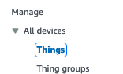
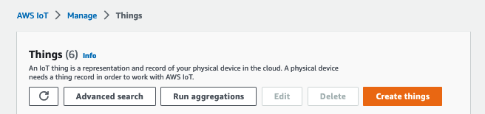





AWS Create Thing
From your AWS Account go to IoT Core¹.
From IoT Core window, on the left margin, select All devices->Things²
Click “Create things” ³
Select “Create single thing” ⁴, click “Next”⁵,
Enter “Thing name”^{6 (note)}, select “Unnamed shadow”⁷ , “Next”⁸.
Select “Skip creating a certificate at this time”⁹
Click “Create thing”¹⁰
Note: the Thing name you create consist of the T&G serial number concatenated with “sn”.
sn1234567890123456
It also correspond at the Common Name (CN) of the T&G Device Certificate
1
2
3
4
6
5
7
8
9
10

Slide 49





AWS Attach Thing/Policy to Certificate
From your AWS Account goto IoT Core¹.
From IoT Core window, on the left margin, select Security->Certificates²
Select the “Certificate” ³ you just created.
From the “Certificate” window⁴, select “Policies” tab⁵, click on “Attach policies” ⁶
In the Policies Pull down, select the Policy “PolicyTied2Thing”⁷
From the “Certificate” window⁴, select “Things” tab⁸, click on “Attach to Things” ⁹
Select the Thing ¹⁰ corresponding to this Certificate. Notice the Certificate Subject CN ¹¹ will match the Thing you just attached ⁹
1
2
3
4
7
11
8
5
6
10
8
9

Slide 50

AWS

Slide 51


Azure group Enrollment
In Terminal window (115,200), enter AT+READCERT=2 to read Signer Certificate
Copy everything from -----BEGIN CERTIFICATE----- to -----END CERTIFICATE-----
Paste this into a text editor. You will need to replace all instance of "\n" with CR (Carriage Return). Save as “WFI32_SignerCert.cer”

Slide 52






Azure group Enrollment
Go to your Azure Account under IoT Central Application¹-> IoT Central Application URL²
Select Permissions³-> Device connection groups⁴
Create New ⁵ Group “WFI32-AnyCLoud” ⁶ ,”Save” ⁷
Add X.509 Signer Cert⁸ and save again⁹
1
2
9
7
6
4
5
3
8

Slide 53


Azure group Enrollment
Once loaded, the Thumprint should match!

Slide 54
Azure Single Device Enrollment
In Terminal window (115,200), enter AT+READCERT=1 to read Device Certificate
Copy everything from -----BEGIN CERTIFICATE----- to -----END CERTIFICATE-----
Paste this into a text editor. You will need to replace all instance of "\n" with CR (Carriage Return). Save as “WFI32_DeviceCert.cer”

Slide 55






Azure Single Device Enrollment
Go to your Azure Account under IoT Central Application¹-> IoT Central Application URL²
Select “Devices” ³, +New⁴, Enter unique CN ”sn0123BF8C8062EBEF01” ⁵, create ⁶
Edit ”sn0123BF8C8062EBEF01” ⁷, click “Connect” ⁸, select “Individual Enrolment” ⁹, select “X.509” ¹⁰ and upload 2 times your Device Cert ¹¹
Save ¹²
Your device is ready to connect!
1
2
7
4
3
8
5
9
10
11
6
12

Slide 56
Circular Buffer
First message..
First message..Second message..
First message..Second message..Third messa
ge..
First message..Second message..Third messa
ge..Fourth message..F
ifth message..Sixth m
essage..
First message..Second message..Third messa
ge..Fourth message..F
ifth message..
age..message..Second message..Third messa
ge..Fourth message..F
ifth message..Sixth m
essage..Seventh mess
First message..Second message..Third messa
ge..Fourth message..

Slide 57
Circular Buffer
Linear Buffer
First message..
First message..Second message..
First message..Second message..Third messa
ge..
First message..Second message..Third messa
ge..Fourth message..F
ifth message..Sixth m
essage..
First message..Second message..Third messa
ge..Fourth message..F
ifth message..
age..message..Second message..Third messa
ge..Fourth message..F
ifth message..Sixth m
essage..Seventh mess
First message..Second message..Third messa
ge..Fourth message..
First message..
First message..Second message..
First message..Second message..Third messa
ge..
First message..Second message..Third messa
ge..Fourth message..F
ifth message..Sixth m
essage..
Seventh message..ond message..Third messa
ge..Fourth message..F
ifth message..Sixth m
essage..
First message..Second message..Third messa
ge..Fourth message..F
ifth message..
First message..Second message..Third messa
ge..Fourth message..

Slide 58
First message..
First message..
First message..Second message..
First message..Second message..Third messa
ge..
First message..Second message..Third messa
ge..Fourth message..F
ifth message..Sixth m
essage..
First message..Second message..Third messa
ge..Fourth message..
age..message..Second message..Third messa
ge..Fourth message..F
ifth message..Sixth m
essage..Seventh mess
First message..Second message..Third messa
ge..Fourth message..F
ifth message..

